Slide 1
On Noise Removal
EECS 442 Final Project, Nat Shi

Slide 2
Primary Question
Introduction
Related Work
Method
What methods exist for removing noise from audio, and can the autoencoder architecture be applied to such?
Experiments
Conclusion

Slide 3
Motivation
Introduction
There are many applications which could benefit from selectively removing or isolating sounds from audio
Potential to make audio experiences more bearable for certain audiences
(And some personal curiosity about working with audio)

Slide 4
Application side:
Introduction
Practical niche audio concerns:
Call audio processing
Post-processing of recordings for various purposes
Educational or research materials
Commercial products
Preprocessing step for further audio-related querying or classification tasks?
Varying sensory experiences:
Misophonia
Sensory processing disorder
Other neurodivergent and/ or perceptual conditions
To what degree can machine learning be integrated with the consumer audio experience?

Slide 5
Related Work
Introduction
Related Work
Related techniques
Similar problems
References
Method
Experiments
Conclusion

Slide 6
Similar Problems
Related Work
Wave-U-Net: audio track separation
Given audio, output separated tracks
Based off of original U-Net architecture
Uses upsampling instead of convolution
Conv-TASNet: speech separation
Convolutional architecture with masking mechanism

Slide 7
Related Techniques
Related Work
Traditional:
Spectral Subtraction
Estimate and subtract noise profile in frequency domain
Spectral Gating
Filter by frequency domain
Wiener Filtering
Estimate noise power spectrum and apply linear time-invariant filter
Deep learning:
SEGAN (Speech Enhancement Generative Adversarial Network)
Uses GAN to distinguish between real and enhanced audio
Facebook Denoiser
Convolutional AE with LSTM

Slide 8
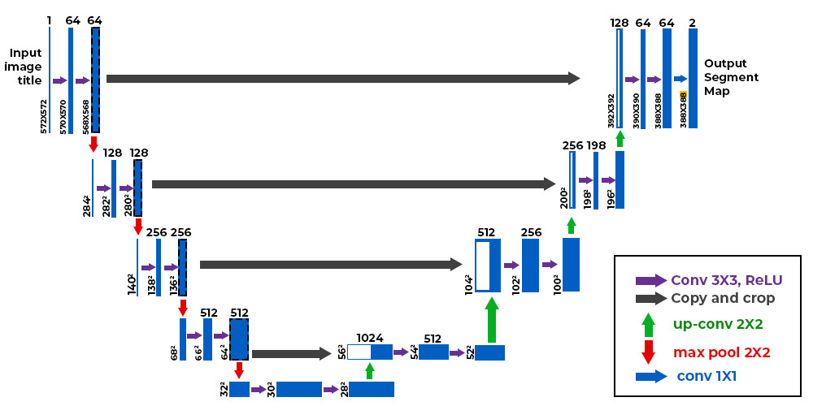
Method
Introduction
Related Work
Model: variants of U-Nets
Method
Experiments
Conclusion

Slide 9
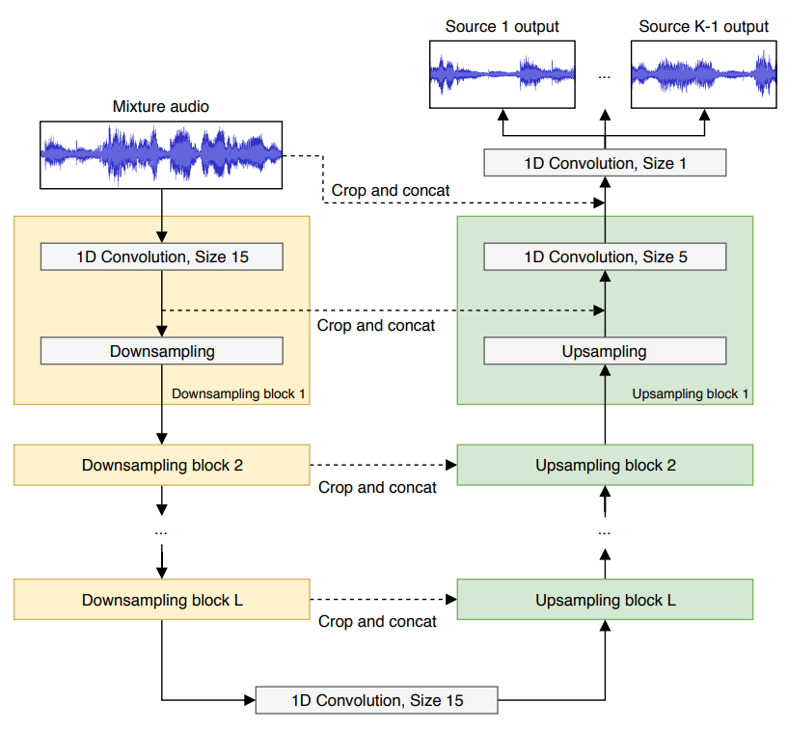
Model
Find function F modeled by U-Net such that given noisy audio input N, produce cleaned audio output C
C = F(N)
Method
Original idea: obtain Mel spectrogram and stick through U-Net architecture.
Later realized raw audio can also be transformed into tensor with decent results, such as in Wave-U-Net:

Slide 10
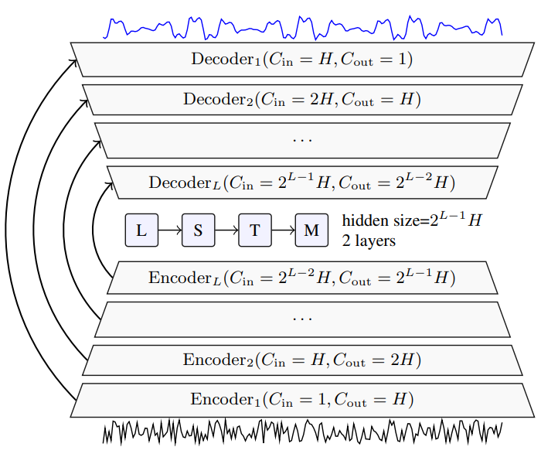
Method
Settled on using raw audio, normalized and trimmed to same size, reduced to same sampling rate.
Used architecture with 4-5 encoder layers and bidirectional LSTM, largely referencing Facebook denoiser.

Slide 11
Data
Results
Introduction
Related Work
Method
Experiments
Conclusion

Slide 12
Data
Experiments
Method
Original idea:
Add and remove specific sounds
Add and remove specific timbres
Remove background (environmental) sounds from audio
Remove orofacial trigger sounds

Slide 13
Data
Experiments
Method
Original idea:
Add and remove specific sounds
Add and remove specific timbres
Remove background (environmental) sounds from audio
Remove orofacial trigger sounds
However:
Finding actual datasets proves difficult
Consistent sampling rates and audio formats
Resorted to simple adding of environmental noise (.wav files) and existing background noise speech dataset

Slide 14
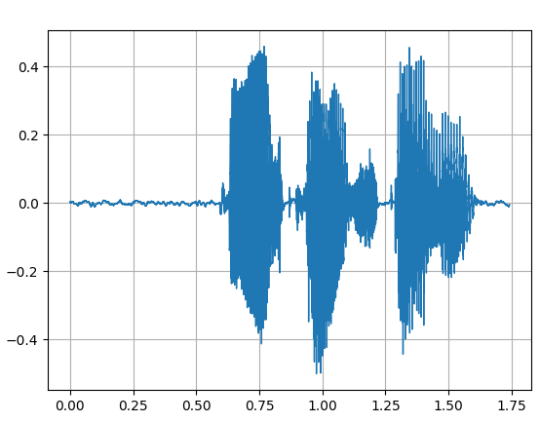
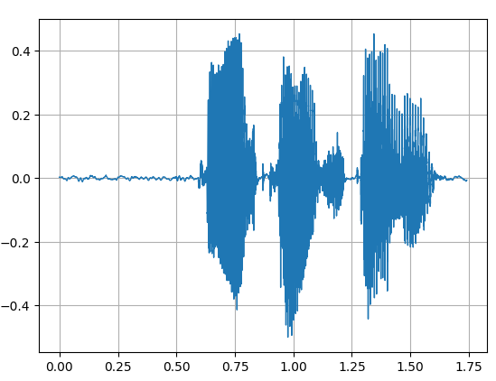
Data
Experiments
Method
48k
16k

Slide 15
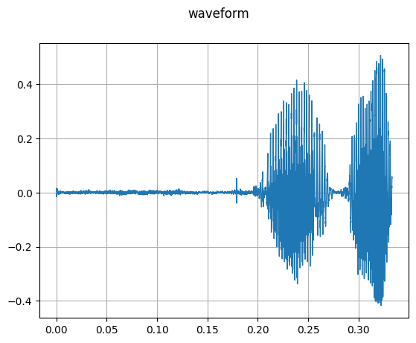
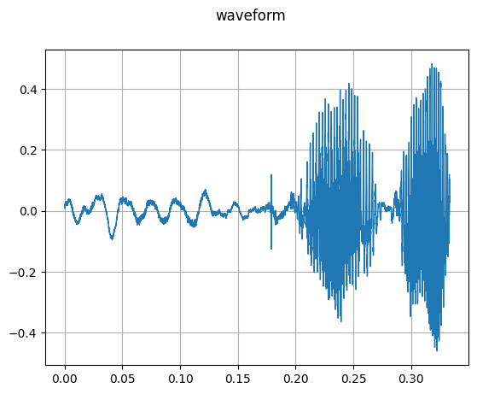
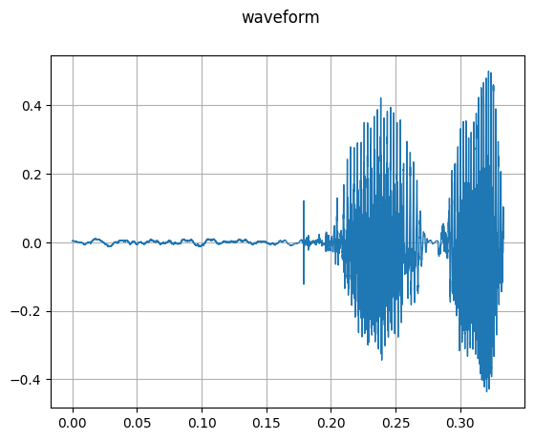
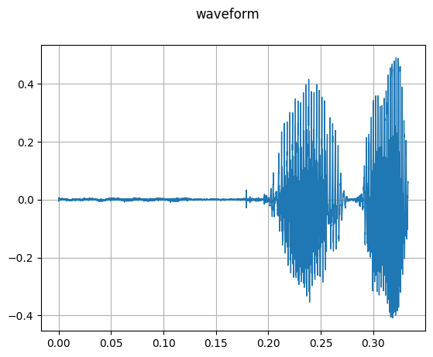
Results
Experiments
Method

Slide 16
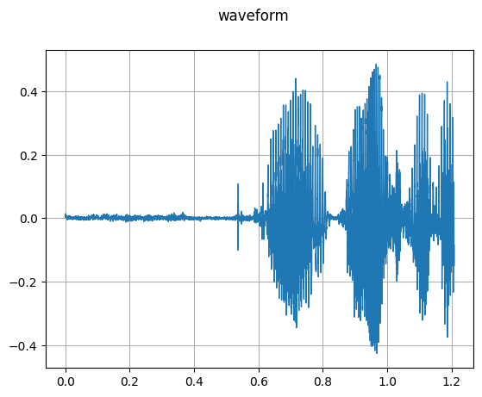
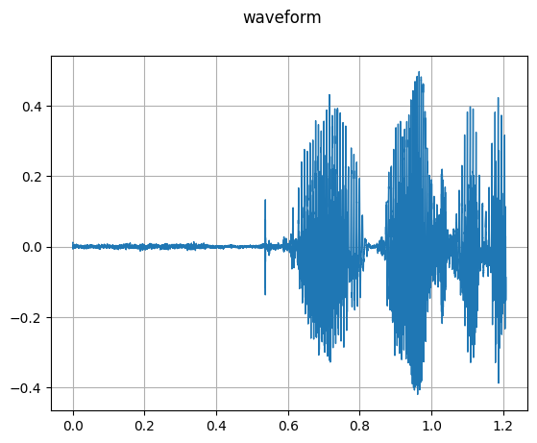
Results
Experiments
Method

Slide 17
Conclusion
Introduction
Related Work
Results compared to speed and efficiency of training and dataset size
Extensions:
Online processing
Additional exploration of qualitatively impactful thresholds
Other model components (mix and match)
Method
Experiments
Conclusion

